Slide 1
RAMBIA Profile
Health
Education
Livelihoods

Slide 2
Our history
Rwenzori Mountains Baghuma Integrated Association (RAMBIA) is an indigenous non-governmental developmental and voluntary organization formed in 1993, reflecting the desire of the rural population to develop and implement strategies for improving the standard of living. We fight Ignorance (through education), Poverty (through livelihoods enhancement) and Disease (through health promotion).
The immediate community served by RAMBIA is populated predominantly by subsistence farmers who because of the inaccessibility of the terrain have difficulty getting their crops to market as well as accessing the limited health care and education facilities. In particular, it is difficult for expectant mothers to get to a hospital to deliver their babies, and RAMBIA’s Health Centre provides essential services to mothers and their children who otherwise would have to give birth at home.
This part of mid-western Uganda has been characterized by high HIV/AIDS prevalence and from the early 1990's it suffered a protracted ADF armed rebellion resulting into high numbers of orphans and vulnerable children. Rambia Orphanage School has been established to respond to this need.
In the early 1990's, a group of visionary community members started RAMBIA, what has now evolved into a community service organization working to improve the health, education and poverty situation of the community.

Slide 3
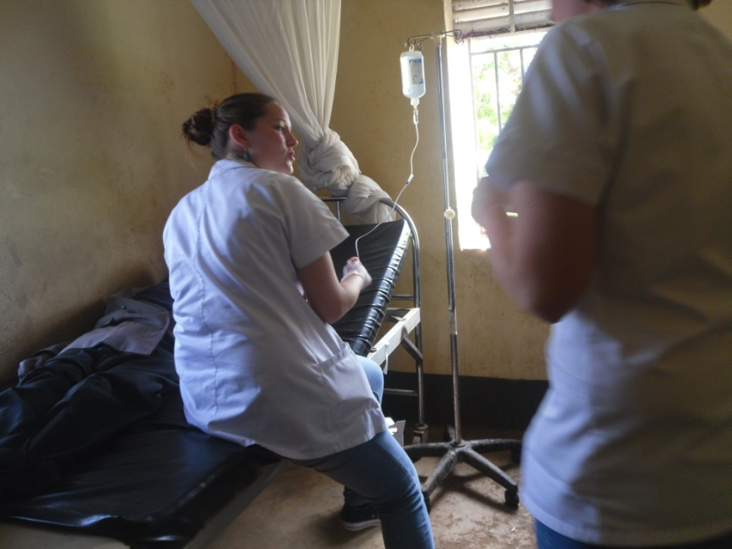
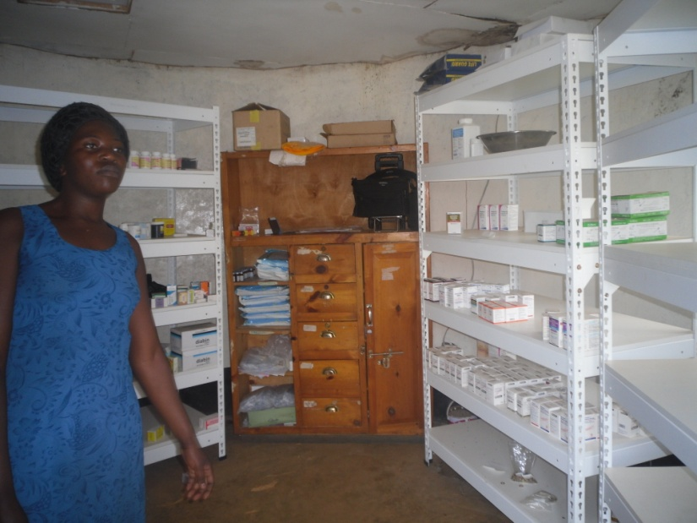
RAMBIA health centre began in 1997 at a level of health centre II, offering only OPD services. Ever since, the centre has expanded to a level of health centre III, providing a range of services including, maternity services, antenatal and postnatal care, HIV/AIDs care, inpatient services and community outreaches.
RAMBIA Health Centre

Slide 4
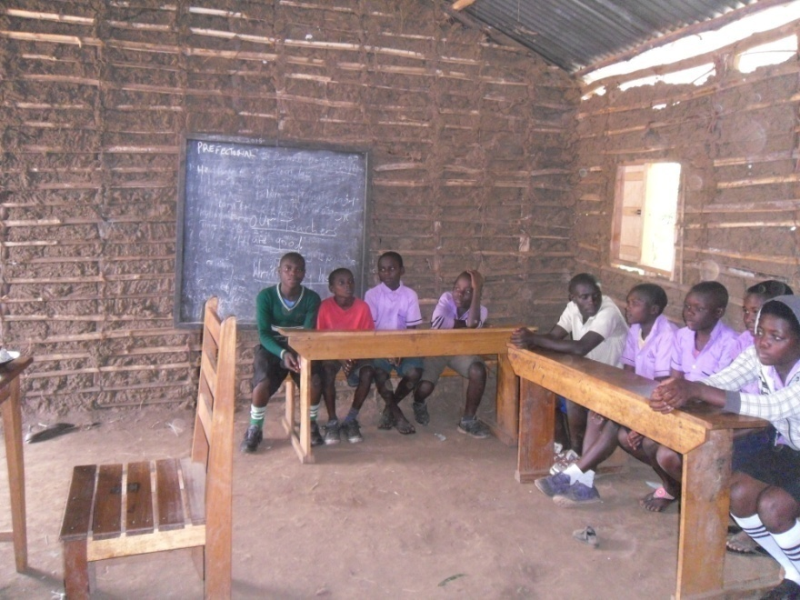
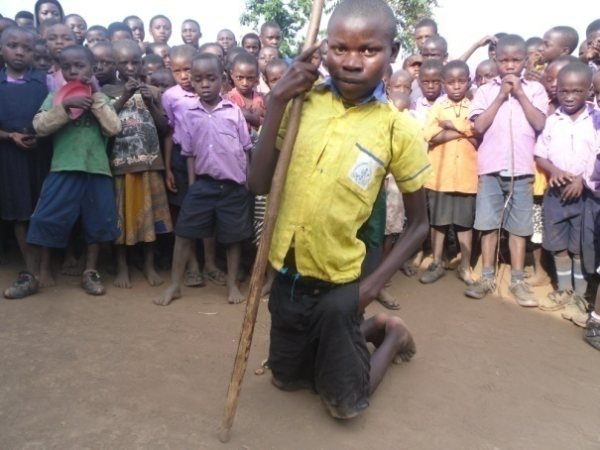
RAMBIA orphanage primary school 2013 with 150 children. Enrolment has grown to over 400 children. The school was established to provide inclusive, quality and affordable primary education to orphans and vulnerable children, who would otherwise be excluded from the mainstream education system provided by government and private profit oriented institutions.
RAMBIA Orphanage Primary School

Slide 5
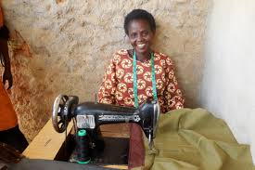
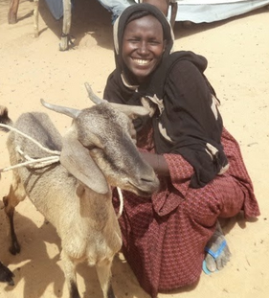
RAMBIA implements community livelihood projects especially targeting poor women. We believe that women play a leading role in the livelihood of countless households , and that small start-up can have a far reaching impact.
Community Livelihoods

